Slide 1




Monitoring and Analyzing Particulate Matter in
Regard to Air Quality within an Indigenous Community
Kaitlin Murphy
Northern Arizona University
Mansel Nelson
NASA Space Grant Presentation

Slide 2
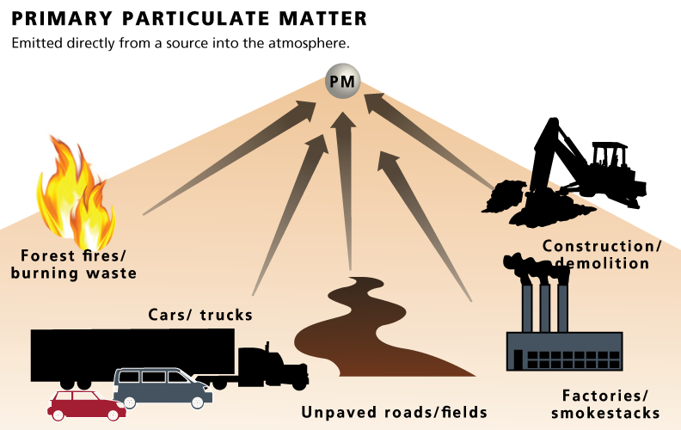
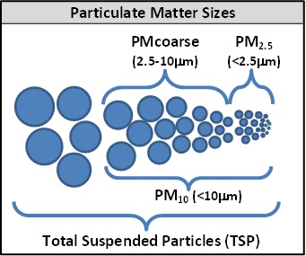
Starts with PM
Air can be contaminated by a number of sources including, not limited to:
  Dust, pollen, soot, smoke, & liquid droplets.
Particles from these sources can range in size, from coarse, fine to ultra fine.

Slide 3
Why the concern for PM?
Ambient PM has been shown to have a harmful impact on respiratory health ( “Air Pollution Particulate Matter” 2005).
Particulate Matter: Transportation contributes to PM in the air.
Even with guidelines from the NAAQS, monitoring is not ready available in most places, particularly in tribal communities.
  NAAQS Standard 2013
    PM2.5: 12.0 micrograms per cubic meter (mg/m₃).
    24-hour PM2.5 standard at a level of 35 mg/m₃.

Slide 4
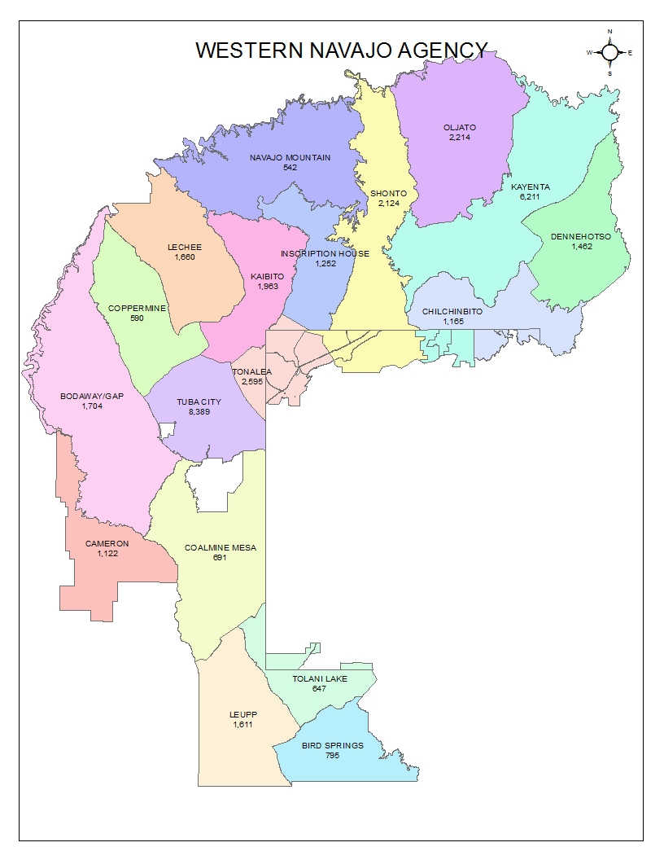
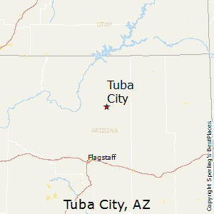
Introduction
Objective of this research project is determine the accuracy and reliability of air quality data collection:
Common in indigenous communities for the average family to travel great lengths weekly.
Opportunity to explore/research an area so close to Flagstaff not well-known or traveled.
Area of Focus: Northern Arizona, Navajo Nation-Western Agency, Namely Tuba City.
UTAH
Notes:
Purpose: To explore environmental impacts traveling has on air quality on these communities.
Heard from schools in Cameron and Shonto about potential to setup monitors

Slide 5
Aspects of My Research
Research
Educational Outreach
Fieldwork & research to monitor air quality:
Setting Up Purple Air Monitoring system
  Before arriving, monitors were already set up at two schools
  Oversaw installation of 2 different schools
AQ Treks
  2018: AQ data collected during the school year with outreach events
  2019: Fieldwork for this project
Working with schools from the greater Tuba City region under EEOP
  Mission for this program is to promote STEM & environmental science education for grades K-12
  Educating middle-schoolers about particulate matter
Tabling events:
  Interacting with students in a more social setting
Notes:
For the Purple Air projects: reaching out to schools was first hurdle to jump over. Dropping off devices and coordinating with school faculty and internet access also had to be considered.

Slide 6
Setting up Monitors in the Community
Through Purple Air & AQ Treks
In order to determine and establish a monitoring network in a common native community, it would be best to look at the systems used to measure.
Best way to accomplish this was by using two different systems and then comparing results to gage reliability and accuracy.

Slide 7
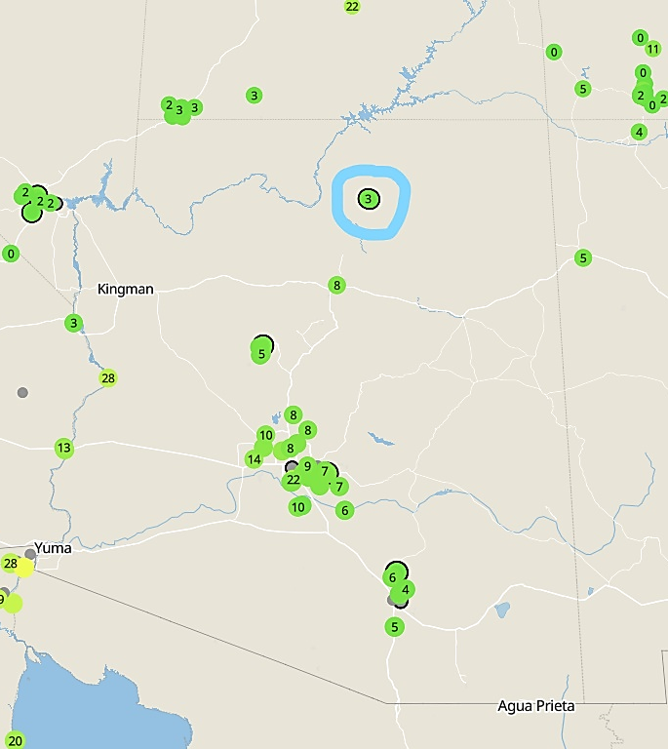
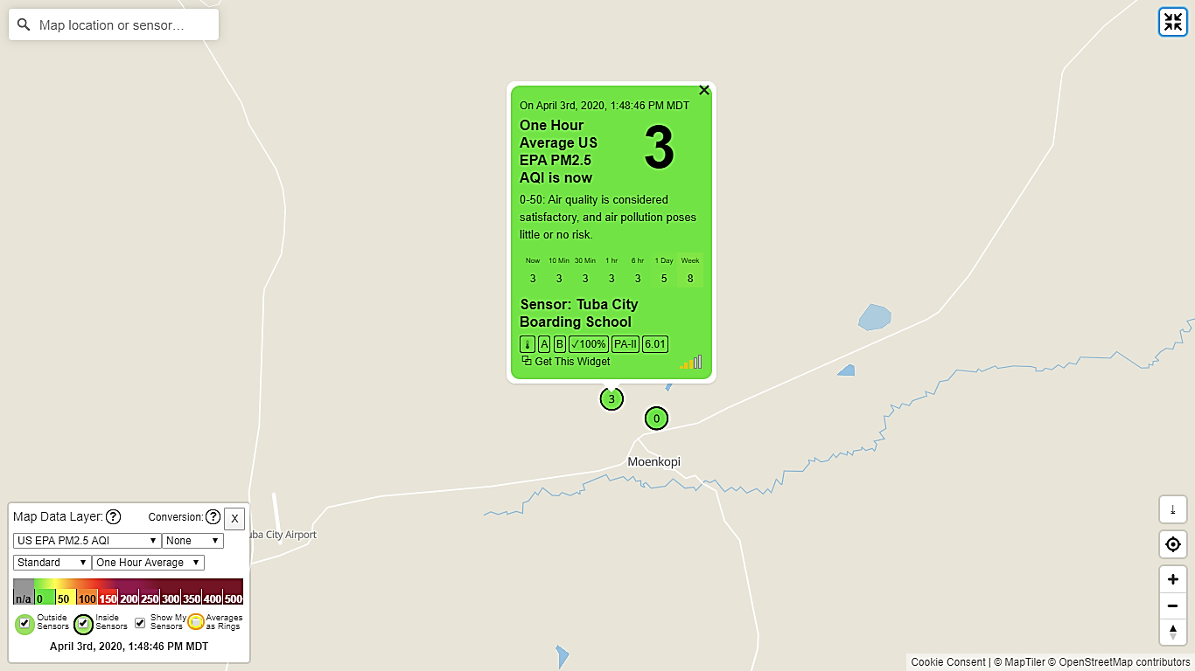
Purple Air Monitoring Network
  The two active monitors located in Tuba City were monitored over the coarse of Academic School year from Sept.-Feb.
Flagstaff
  Displays Global network of online monitors that read and record data in real time.

Slide 8
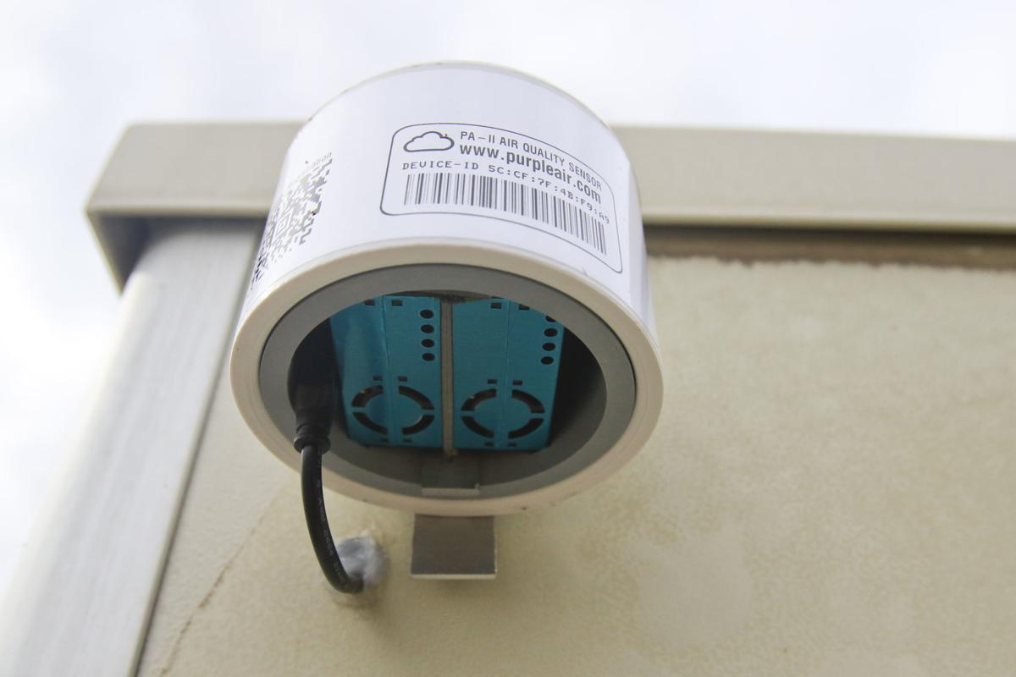
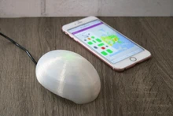
Purple Air Outdoor Monitor
Purple Air Indoor Monitor: This model was used to monitor AQ for this project

Slide 9
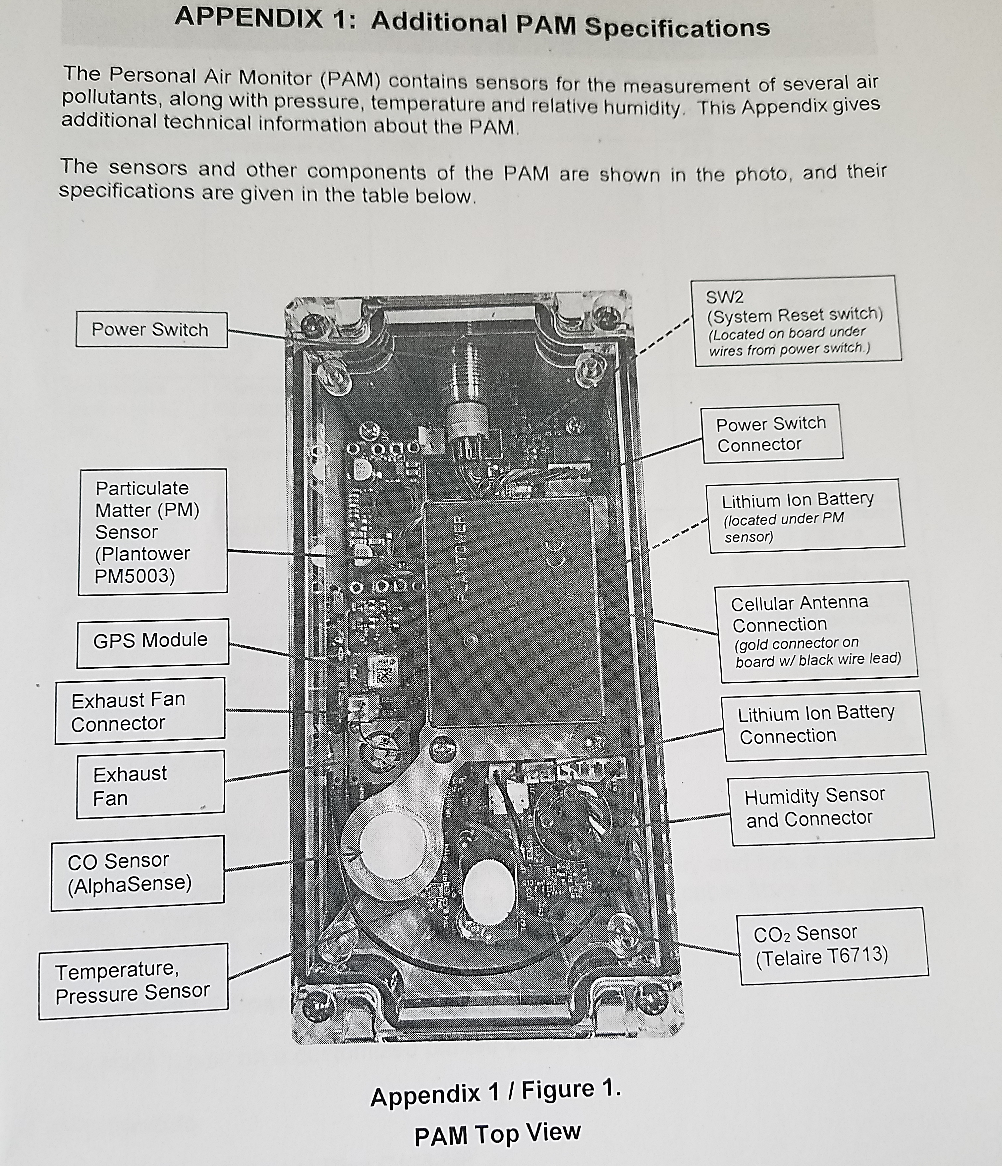
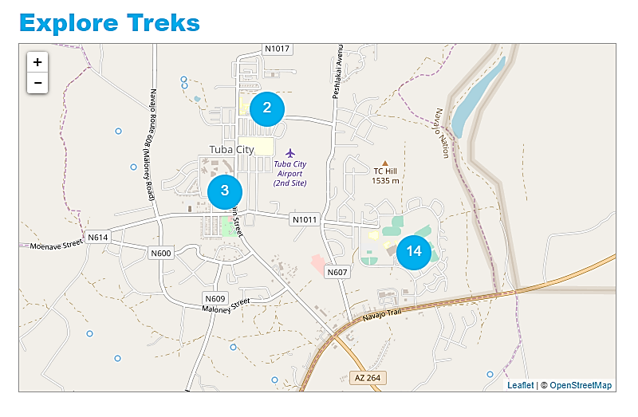
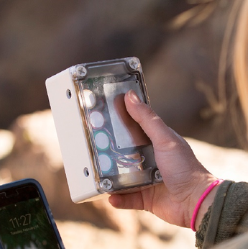
AQ Treks
Measured AQ in real time. Data collected back in 2018 was compared to trends in CO2 levels and PM 2.5

Slide 10
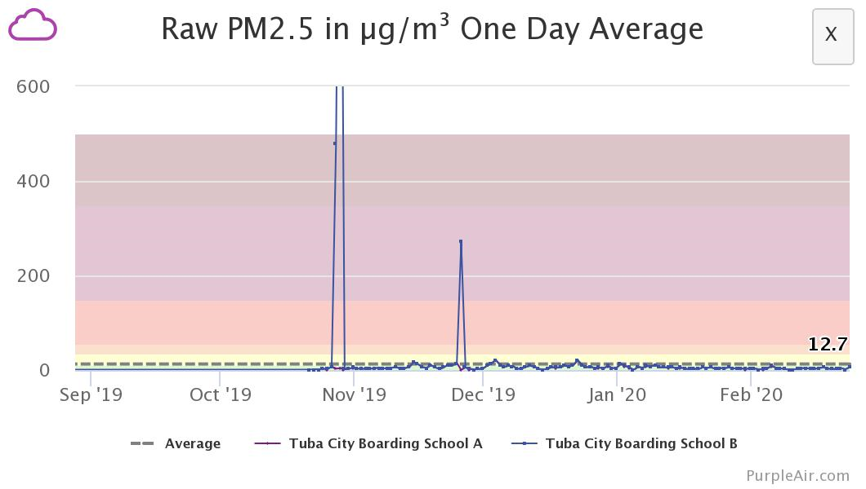
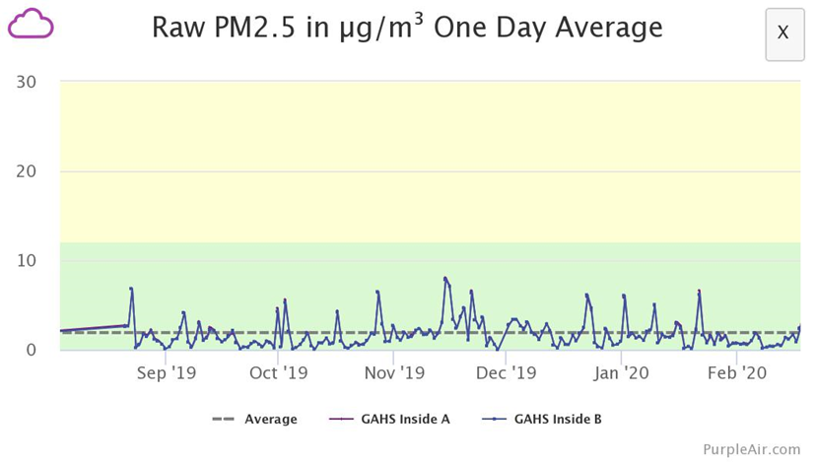
Data: Purple Air
Looking at real time monitoring over the past school (September-Feb).
Two Locations: GAHS & TCBS

Slide 11
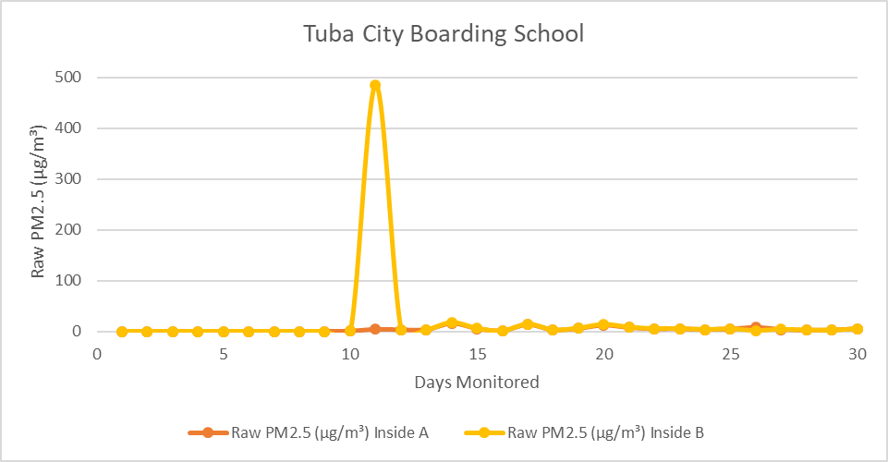
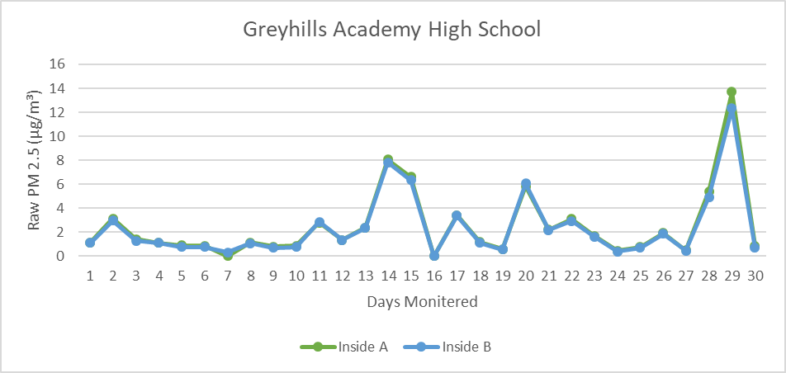
Purple Air Monitor Trends:
 | Average | Standard Deviation
GAHS1 | 2.47933333 | 2.912146895
GAHS2 | 2.367 | 2.712046116
TCBS1 | 5.57380952 | 4.121886069
TCBS2 | 28.4761905 | 104.6985879
Raw PM2.5 (µg/m³) was recorded as well as real time AQI level for both monitors.
Things to note:
AQ was recorded every 6-7 days, starting on First of the month
Preferably record on school day, weekends were included
Students had number of early dismissals and holidays that were considered
TCBS monitor was down until 9/21

Slide 12
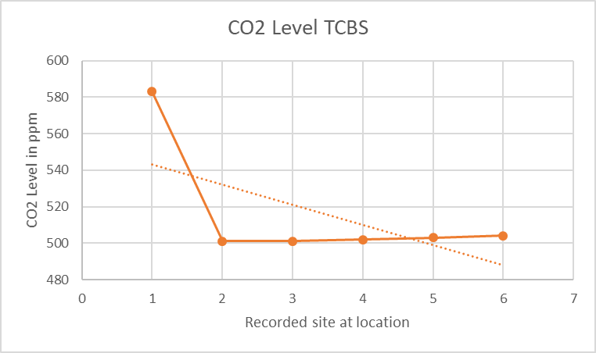
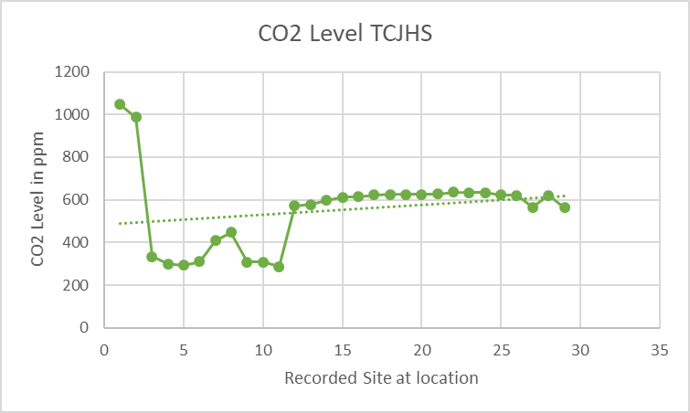
AQ Treks for TCBS and TCJHS
Average | Median | Stdev
180.4482759 | 613 | 185.6628
Average | Median | Stdev
515.6667 | 502.5 | 33.00707

Slide 13
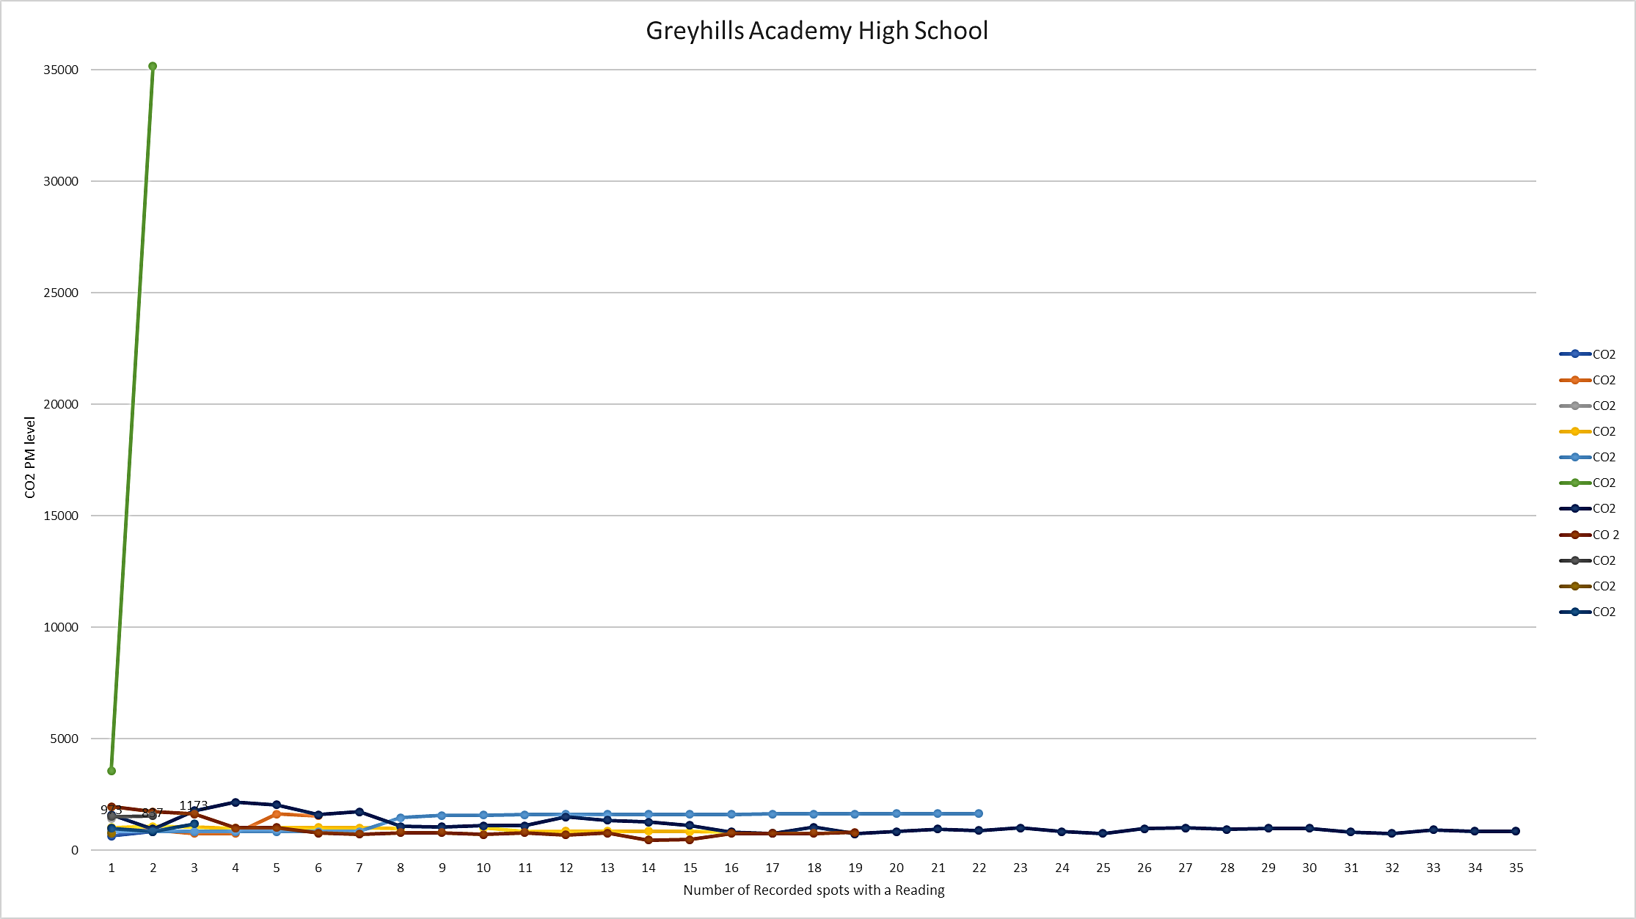
Data: AQ Treks For GAHS.
AQ Trek ID
 | 1020
 | 1019
 | 1018
 | 1017
 | 1009
 | 1008
 | 1007
 | 1006
 | 1004
 | 1002
 | 999

Slide 14
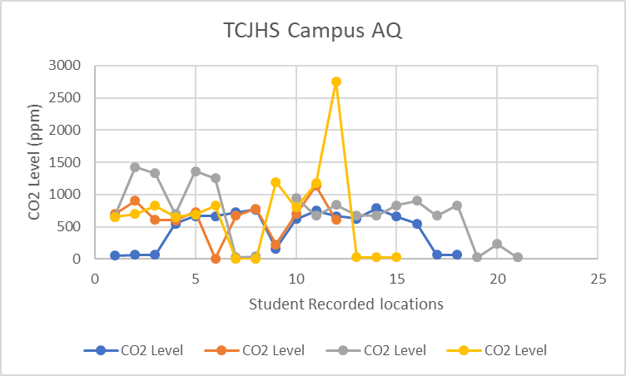
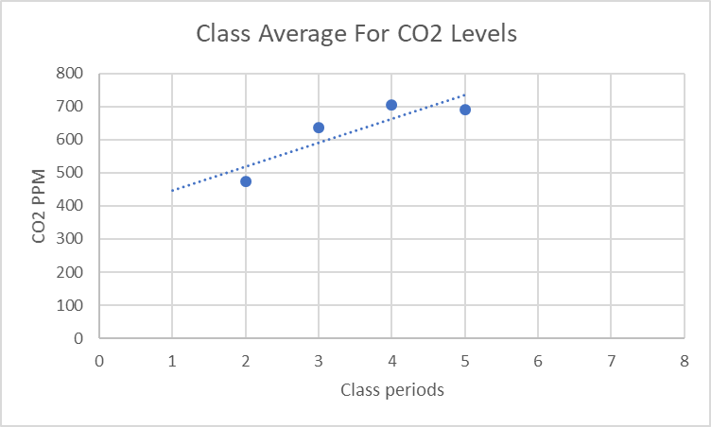
EEOP conducted an outreach activity that involved students recording CO2 levels across the campus at random (students chose where to record with allowed class time) back in 2017
Overall school average: 626.75 ppm, St dev: 436.01
Things to note:
5 classes actually participated, however 2nd hour did not write down results

Slide 15
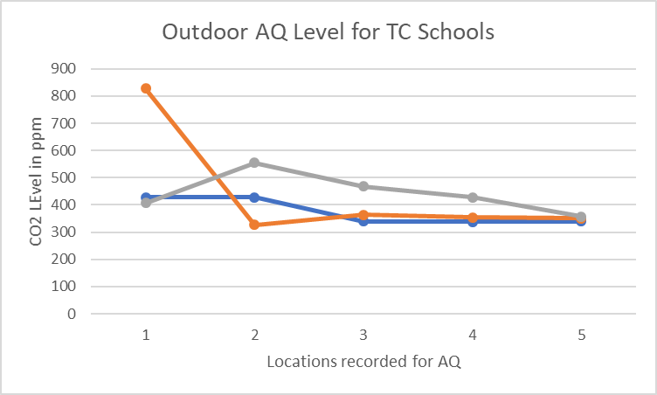
AQ Treks Data 2020
Outdoor Averages for
TCBS: 442.8ppm, s.d. 73.93037
TCJHS: 374.6 ppm, s.d. 48.75244
GAHS: 444.4, s.d.214.89
Data collected on March 17th, 2020 on streets and roadways at the following Schools
TCJHS (Blue)
GAHS (Orange)
TCBS (Grey)
Locations were recorded at random along the school grounds.

Slide 16
Analysis
High spikes found within classrooms
  TCBS Inside monitor B saw extremely above average level on 10/28 (485 µg/m³ or ppm)—cause or source of spike is unknown.
  Avg for classroom monitor was 28.47 compared to TCBS Inside A monitor avg 5.57.
Outdoor monitors see larger range of ppm recorded.
  Especially in the case of 2018 TCJHS visit and 2020 visit.
Daily routine for school has to be considered:
  Recorded during different time periods: (7-10 am, 4-6 pm)
  Level of activity throughout day or year can effect levels of PM

Slide 17
Conclusions
Hopes for the future: With more time, there is the definite possibility for establishing a more reliable, and accurate, air quality monitoring system.
Amateur data collection should be more structured—because no method to collecting in the past, hard to build off that.
Level of exposure for students can be concerning, sporadic brief spikes throughout the day and into the school year.

Slide 18
Cheat Sheet
ITEP= Institute for Tribal Professionals
EEOP= Environmental Education Outreach Professional
EPA= Environmental Protection Agency
NAAQS=National Ambient Air Quality Standards
PM=Particulate Matter
TCBS=Tuba City Boarding School
TCJHS= Tuba City Junior High School
GAHS=Greyhills Academy High School
NN= Navajo Nation
NNEPA=Navajo Nation Environmental Protection Agency
STEM=Science, Technology, Engineering & Mathematics
SD= Standard Deviation

Slide 19
Acknowledgements
NASA Space Grant Program
Institute for Tribal Environmental Professionals
  Mansel Nelson
  Julaire Scott
Environmental Education Outreach Program
Schools that Participated in Outreach
  Tuba City Junior High School
  Greyhills Academy High School
  Dzil Libei Elementary School
  Shonto Preparatory School
  Rocky Ridge Boarding School
Northern Arizona University
Purple Air monitoring system
AQ Treks
https://www.eia.gov/state/?sid=AZ#tabs-2
EPA. 2013. Federal Register. https://www.govinfo.gov/content/pkg/FR-2013-01-15/pdf/2012-30946.pdf
GreenFacts. 2005. “Air Pollution Particulate matter”. https://www.greenfacts.org/en/particulate-matter-pm/

